Slide 1


Noida Institute of Engineering and Technology, Greater Noida
Expansion of harmony from self to entire existence
Unit: V
Understanding the human being comprehensively-Human Aspirations and its fulfillment
(KOE-069)
Shyam Lal Sharma
Assistant Professor
ME
B Tech (6th Sem)

Slide 2
CONTENT
Course Outcomes
CO-PO and PSO mapping
Unit -5 Syllabus
Unit -5 Objective, Prerequisite
Daily Quiz
MCQ
Weekly Assignment
Previous year Question papers
Expected Questions for University exam
Related Links for Unit -5

Slide 3
COURSE OUTCOME
At the end of the course, the student shall be able to
CO 1 | Student would be able to develop the clarity about human aspirations, goal, activities and purpose of life.
CO 2 | The clarity about Right Understanding could be possible for students.
CO 3 | Students would become competent to understand the harmony in nature/existence .
CO 4 | To help students in participating in the nature/existence.
CO 5 | To help the students to develop the understanding of human tradition and its various components.

Slide 4
CO-PO AND PSO MAPPING
CO – PO Mapping
Course Outcome | PO 1 | PO 2 | PO 3 | PO 4 | PO 5 | PO 6 | PO 7 | PO 8 | PO 9 | PO 10 | PO 11 | PO 12
CO 1 | 1 | - | 1 | - | 1 | 2 | 2 | 3 | 3 | 2 | 1 | 3
CO 2 | - | - | 1 | - | 1 | 2 | 1 | 3 | 3 | 3 | 2 | 3
CO 3 | 1 | - | 1 | - | 1 | 2 | 2 | 3 | 3 | 3 | 2 | 3
CO 4 | 1 | - | 1 | - | 1 | 2 | 2 | 3 | 3 | 3 | 2 | 3
CO 5 | 1 | - | 1 | - | 1 | 2 | 2 | 3 | 3 | 3 | 2 | 3
CO – PSO Mapping
CO | PSO1 | PSO2 | PSO3 | PSO 4
CO 1 | 1 | 1 | 1 | 1
CO 2 | 1 | 1 | 1 | 1
CO 3 | 1 | 2 | 1 | 1
CO 4 | 1 | 2 | 1 | 1
CO 5 | 1 | 1 | 1 | 1

Slide 5
UNIT-5 SYLLABUS
    TOPICS
Human Conduct
All Encompassing Resolution-Wisdom
All Encompassing Resolution-Science, Science of behaviour
All Encompassing Resolution-Science of Work & Participation
Undivided Society, Universal Human Order, Human Tradition

Slide 6
UNIT -3
Objective of the unit:
Understanding different aspects of All-encompassing Resolution, Holistic way of living for Human Being with All-encompassing Resolution covering all four dimensions of human endeavour viz., realization, thought, behavior and work (participation in the larger order) leading to harmony at all levels from self to Nature and entire Existence
Pre-requisite:
Student should be familiar to concepts of right understanding, harmony, Awakening of higher activities of the self and higher activities then guiding the lower activities of the self. Realisation within and Expression outside.

Slide 7
Prerequisite to Topic 1
Prerequisite
Student should be familiar to concepts of right understanding, harmony, justice in relationships, broadening of the 9 feelings and expressions.

Slide 8
Introduction to Topic 1
Name of Topic | Objective of Topic | Mapping with CO
Human Conduct | Students will be able to distinguish four states in their self – Happiness, Peace, Satisfaction, Bliss Also, they can observe and identify the places to have more Perseverence, Bravity and Generosity for others. | CO 5

Slide 9
Knowledge of Human Conduct- Model 2[CO5]
Mentioned in the last session,
We can look at Human Conduct from different angles giving rise to different formulations.
We are looking into 2 formulations of Human Conduct – Model 1 and 2
In Model 1, we have been seen one description of complete human conduct
Now, in Model 2, we will try to investigate into another description of human conduct
In model 2, human conduct is articulated in terms of
  3.1.3.1. Human Values
  3.1.3.2. Policy
  3.1.3.3. Character

Slide 10
Knowledge of Human Conduct- Model 2[CO5]
Mentioned in the last session,
We can look at Human Conduct from different angles giving rise to different formulations.
We are looking into 2 formulations of Human Conduct – Model 1 and 2
In Model 1, we have been seen one description of complete human conduct
Now, in Model 2, we will try to investigate into another description of human conduct
In model 2, human conduct is articulated in terms of
  3.1.3.1. Human Values
  3.1.3.2. Policy
  3.1.3.3. Character

Slide 11
Knowledge of Human Conduct
[CO5]
3.1.3.1. Human Values – Understanding "What to do as a human being" and "What not to do as a human being"
3.1.3.2. Policy – Detail, thought of "how to do" Human Constitution. Includes plan, program, implementation, results, evaluation
    Policy for enrichment (arth neeti) of Self , Body, Physical Facility
    Policy for protection (rajya neeti) of Self , Body, Physical Facility
    Policy for right utilisation (dharm neeti) of Self , Body, Physical Facility
3.1.3.3. Character – Compassionate behaviour, work & participation in larger order on the basis of human values
    Behaviour – ensuring justice, mutual happiness (while also filling the gaps created in ignorance)
    Work – ensuring preservation, mutual prosperity (while also filling the gaps created in ignorance)
    Rightfully acquired wealth (swa-dhan)
    Chastity in conjugal relationship (swa-nari/swa-purush)

Slide 12
Human Values (Identification of Human Values)[CO5]
Understanding the Participation (Role) of Human Being in this Existence
In the Self – Happiness, Peace, Satisfaction, Bliss -------------------- 4
In Universal Human Order – Perseverence, Bravity, Generosity, Kindness, Beneficience, Compassion ------------------------------------ 6
In Human-Human Relationship – Justice
(9 established values + 9 expressed values) --------------------------- 18
4. In Human-Rest of Nature Relationship – Utility, Artistic value ----- 2
Outcome of understanding – natural acceptance of human values, natural & definite participation in larger order
Understa= transformation of consciousness, definite human conduct on the basis of understanding the values
Present state: Some attention on #4 (or 2 values out of 30)

Slide 13
Human Values (Identification of Human Values)[CO5]
Understanding the Participation (Role) of Human Being in this Existence
Being in harmony in the Self on the basis of realisation of co-existence
– Happiness, Peace, Satisfaction, Bliss in the Self
2. Participation in the Universal Order or Universal Human Order as a human being with human consciousness
– Perseverence, Bravity, Generosity,
Kindness, Beneficience, Compassion
3. Participation in Human-Human relationship – Justice
– 9 established values – trust, respect, affection… Love
– 9 expressed values –
Participation in Human-Rest of Nature relationship
– Utility value, Artistic value

Slide 14
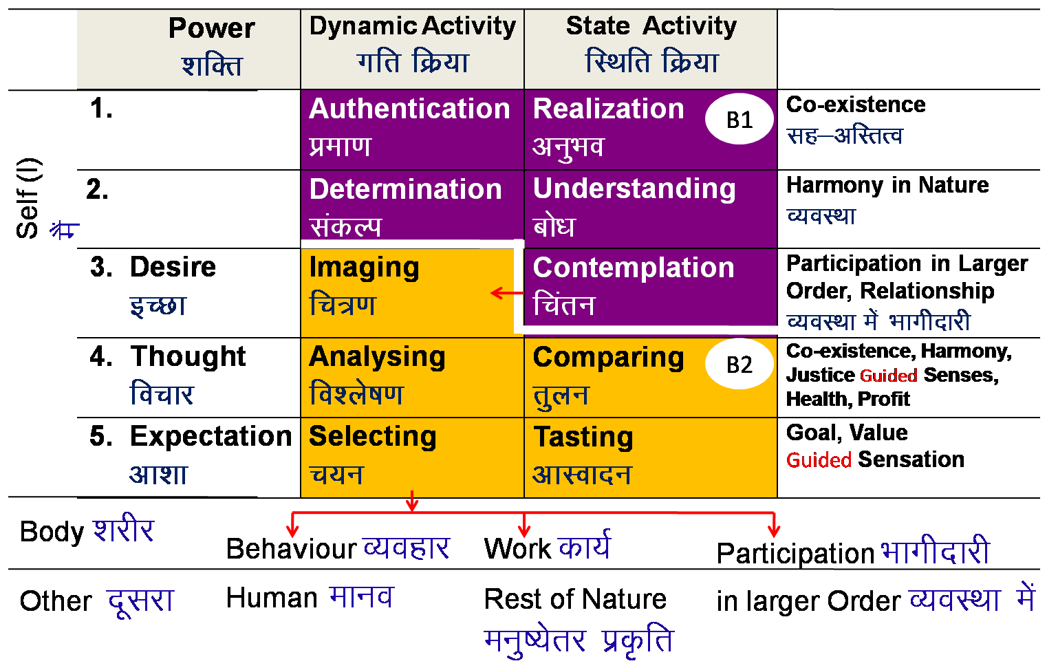
Space
REALISATION WITHIN
Bliss
Satisfaction
Peace
Happiness
Harmony at the level of determination and understanding
Understanding = clarity about the harmony in nature
Determination = all my effort will now be for mutual enrichment
Understanding and determination is guided by realisation and authentication
Realisation = clarity about co-existence (submergence of nature in space)
Authentication = all my effort will now be for authenticating co-existence (submergence of nature in space)
Harmony at the level of desire and contemplation
i.e. desires are based on (guided by) contemplation of the participation of human being in entire nature. Desires are definite and it is clear that there is every provision in nature for their fulfillment
b) Desire and contemplation are guided by understanding and determination
Harmony at the level of selecting and tasting
i.e. selecting is on the basis of goal and value guided sensation based tasting
Selecting and tasting is guided by comparing and analysing
Harmony at the level of analysing and comparing
i.e. analysing on the basis of co-existence, harmony, justice guided senses-health-profit based comparing
Analysing and comparing is guided by contemplation and desire
Mutual Happiness
mHk; lq[k
Mutual Prosperity
mHk; le`f)
Fulfillment of Human Goal
Ekkuo y{; dh iwfrZ
Human Tradition
Undivided Human Society
v[k.M ekuoh; lekt
EXPRESSION OUTSIDE
Universal Human Order
lkoZHkkSe ekuoh; O;oLFkk

Slide 15
Fulfillment (tripti) of being Self-organised
[CO5]
Happiness
Harmony at the level of selecting and tasting
i.e. selecting is on the basis of goal and value guided sensation based tasting
Selecting and tasting is guided by comparing and analysing
Peace
Harmony at the level of analysing and comparing
i.e. analysing on the basis of co-existence, harmony, justice guided priya-hit-laabh based comparing
Analysing and comparing is guided by contemplation and desire

Slide 16
Fulfillment (tripti) of being Self-organised
[CO5]
Satisfaction
Harmony at the level of desire and contemplation
i.e. desires are based on (guided by) contemplation of the participation of human being in entire nature. Desires are definite and it is clear that there is every provision in nature for their fulfillment
b) Desire and contemplation are guided by understanding and determination
Bliss
Harmony at the level of determination and understanding
Understanding = clarity about the harmony in nature
Determination = all my effort will now be for mutual enrichment
Understanding and determination is guided by realisation and authentication
Realisation = clarity about co-existence (submergence of nature in space)
Authentication = all my effort will now be for authenticating co-existence (submergence of nature in space)

Slide 17
Participation in the Universal Order as a Human Being[CO5]
= Natural Characteristic of Human Being with Human Consciousness
Perseverence Commitment for living in harmony at all 4 levels with
patience
Bravity Commitment for helping the other to understand harmony
& to live in harmony at all 4 levels
Generosity The commitment to invest one's Self, Body &
physical facility for understanding & living in harmony
at all 4 levels
Kindness Providing means to one who has the ability but not feel the need
Beneficience Helping the other to develop the competence to
utilise the means they already have
Compassion Helping the other unconditionally

Slide 18
Participation in the Universal Order as a Human Being[CO5]
= Natural Characteristic of Human Being with Human Consciousness
Kindness Providing means to one who has the ability but not the
means.
Beneficience Helping the other to develop the competence to
utilise the means they already have.
Compassion Helping the other unconditionally, to develop the
competence as well as the means, to fulfill his needs when he neither has the ability nor the means.

Slide 19
Participation in Human-Human Relationship as a Human Being[CO5]
Trust To be assured that the other intends my happiness &
Foundation Value prosperity
Respect Right evaluation (with the basis that the other is like me and we are complementary to each other)
Affection Acceptance of the other as one’s relative
Care Responsibility & commitment for nurturing and protecting the Body of one’s relative
Guidance Responsibility & commitment for ensuring Right Understanding and Right Feeling in the Self of one’s relative
Reverence Acceptance for Excellence
Glory Acceptance for those who have made effort for Excellence
Gratitude Acceptance for those who have made effort for my Excellence
Love The feeling of being related to all
Complete Value

Slide 20
Participation in Human-Human Relationship as a Human Being [CO5]
Established Value | Expressed Value | Indicators
Trust | Complimentariness | Able to work together सहयोगिता, सहकारिता, सहभागिता
Respect | Compliance Transparency | The other is like me. I am complimentary to the other. Able to rightly evaluate each other
Affection | Commitment | Self-motivated for fulfilling responsibility in relationship (कर्तव्य एवं दायित्व)
Care | Generosity | Offer our self, body, wealth as required मन-तन-धन को आवश्यकतानुसार अर्पित करते हैं
Guidance | Spontaneity | Provides right education-sanskar; Protects from wrong सही शिक्षा-संस्कार, अनुकुल वातावरण देते हैं; गलत से बचाते हैं

Slide 21
Established Value | Expressed Value | Indicators
Reverence | Obedience | Willing to receive the inspiration for what is right (सही की) प्रेरणा स्वीकारने के लिए तत्पर रहते हैं
Glory | Simplicity | Absence of Ego अभिमान का अभाव
Gratitude | Self-restraint | Behaving with courtesy शिष्टता पूर्वक प्रस्तुत होते हैं
Love | Unanimity | To live with feeling of co-existence, relationship with every unit in existence सह-अस्तित्व के भाव में जीना, अस्तित्व की हर इकाई के साथ सम्बन्ध पूर्वक जीना

Slide 22
Participation in Human-Rest of Nature Relationship[CO5]
Utility Value (उपयोगिता मूल्य)
in nurturing Body
in protecting Body
in enhancing capacity of Body for use in societal development (right utilisation)
Artistic Value (कला मूल्य)
(Facilitating enrichment, protection & right utilisation)
Protecting the physical facility
People friendly- Facilitating behaviour (making it convenient for sharing, expressing or receiving knowledge, feeling, thought)
Ease in use- Facilitating work (making it convenient for usage)

Slide 23
Policy – Detail, thought of "how to do"–Human Constitution[CO5]
Includes plan, program, implementation, results, evaluation
    Policy for enrichment (arth neeti) of Self , Body, Physical Facility
    Policy for protection (rajya neeti) of Self , Body, Physical Facility
    Policy for right utilisation (dharm neeti) of Self , Body, Physical Facility
Policy for right utilisation (priority1)
Of Self Policy for investing the Self for Self study- practice and authenticating in living
Of Body Policy to ensure that the Body is used for ensuring right understanding and right feeling in the Self as well as its authentication in living, including behavior, work and participation in larger order
Of PF Policy to ensure the use of PF for nurturing, protection and right utilisation of the Body. Policy for right utilisation of physical facility for relationship and societal order

Slide 24
Policy – Detail, thought of "how to do"–Human Constitution[CO5]
Policy for Protection (priority 2)
For Self Policy for ensuring conducive environment and protecting from unfavourable environment
For Body Policy for ensuring shelter, clothes…
For PF Policy for proper storage
Policy for Enrichment (priority 3)
For Self Policy for education-sanskar, adult education, other efforts for development of sanskar in society like music, dance, drama…
For Body Policy for intake-lifestyle to ensure health of Body
For PF Policy for production with right process & right skills

Slide 25
Character[CO5]
Compassionate behaviour, work & participation in larger order on the basis of human values
    Behaviour – ensuring justice, mutual happiness (while also filling the gaps created in ignorance)
    Work – ensuring preservation, mutual prosperity (while also filling the gaps created in ignorance)
Rightfully acquired wealth (swa-dhan)
Chastity in conjugal relationship (swa-nari/swa-purush)

Slide 26
Rightfully Acquired Wealth[CO5]
Production through labour on rest of nature or physical facility obtained in exchange of service – physical facility endowed with utility value & artistic value
Gift – wealth shared willingly / happily from one’s rightfully acquired wealth on various occasions like festivals (ex. gift in relationship)
Award – physical facility / wealth given with joy in a function to recognise one’s contribution to society and for motivating others

Slide 27
Daily Quiz
_________ deals with what is universally valuable to us, what is conductive to our individual and collective happiness and prosperity in a sustainable way.
Working only for physical facilities is living with ____________.
The basic requirements for fulfilling the aspirations of every human being are ___________, ________ & ___________.
Working for right understanding as the first priority followed by relationship and physical facilities implies living with _________.
Physical facilities are necessary as well as complete for a human being- True /False

Slide 28
Recap of Topic 1
Self – Happiness, Peace, Satisfaction, Bliss
Perseverence, Bravity and Generosity for others.
Compassionate behaviour, work & participation in larger order on the basis of human values
    Behaviour – ensuring justice, mutual happiness (while also filling the gaps created in ignorance)
    Work – ensuring preservation, mutual prosperity (while also filling the gaps created in ignorance)
Rightfully acquired wealth (swa-dhan)
Chastity in conjugal relationship (swa-nari/swa-purush)

Slide 29
Prerequisite to Topic 2
Prerequisite
Student should be familiar to concepts right understanding, harmony, Human being as an Existence, Awakening of higher activities of the self and higher activities then guiding the lower activities of the self.

Slide 30
Introduction to Topic 2
Name of Topic | Objective of Topic | Mapping with CO
All Encompassing Resolution-Wisdom | Students will be able to observe that the problems that we see at any level – individual, family, societal or at the level of entire nature – are nothing but absence of fulfilment of some part of the human goal. | CO 5

Slide 31
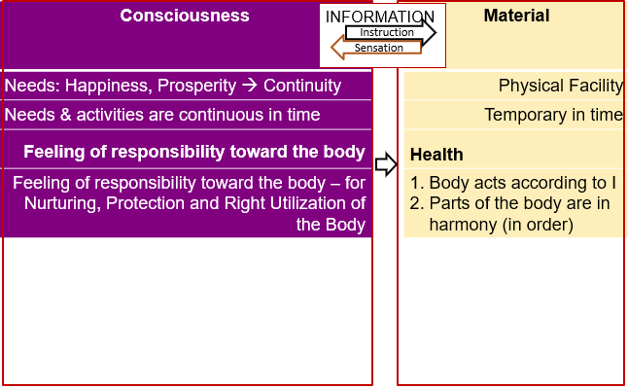
Self and Body [CO5]

Slide 32
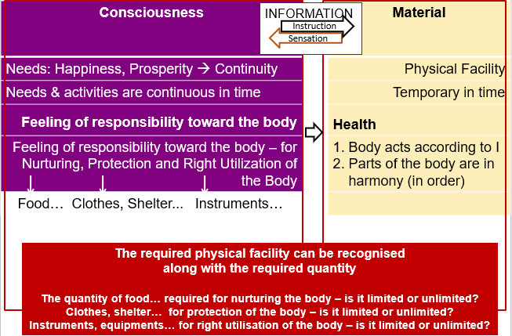
Self and Body [CO5]

Slide 33
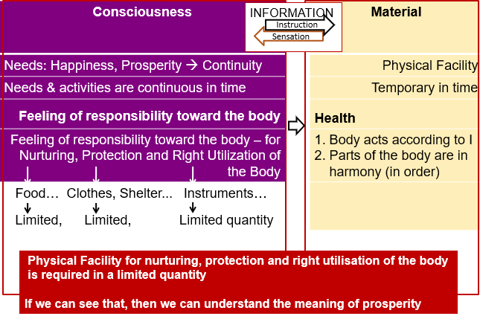
Self and Body [CO5]

Slide 34
Understanding Prosperity [CO5]
Prosperity – The feeling of having more than required Physical Facility
2 1
  Identification of required physical facility (including the required quantity) - with right understanding
    Ensuring availability/ production of more than required physical facility - with right skills
A prosperous person thinks of right utilisation, nurturing the other.
A deprived person thinks of accumulation, exploiting the other.

Slide 35
Categories of Persons [CO5]
We had seen that we can observe two categories of human beings
  Lacking physical facility, unhappy deprived - SVDD – Sadhan Viheen Dukhi Daridra
  Having physical facility, unhappy deprived – SSDD -Sadhan Sampann Dukhi Daridra
(now we can see that if the identification of required physical facility is missing, then one can only shift between category 1 & category 2)
While we want to be –
  Having physical facility, happy prosperous - SSSS – Sadhan Sampann Sukhi Samriddha
This is possible only with
1- the right identification of required physical facility and
2- availability / production of more than required physical facility

Slide 36
Activities of Self [CO5]
 | Force / Power | Activity
1.
2.
3. | Desire | Imaging
4. | Thought | Analysing
5. | Expectation | Selecting/Tasting
Self (I)
Self verification on the basis of Natural Acceptance
3
Preconditioning
1
Partantrata X
Swatantrata √
Body
2
Sensation
Behaviour
Work
Partantrata X

Slide 37
Activities of Self [CO5]
 | Power | Dynamic Activity | State Activity
1. |  | Authentication | Realization
2. |  | Determination | Understanding
3. | Desire | Imaging | Contemplation
4. | Thought | Analysing | Comparing | Unguided Senses, Health, Profit
 |  | Selecting | Tasting | Unguided Sensation
  Self verification on the basis of Natural Acceptance
B1
3
Self (I)
eSa
Preconditioning
1
Self (I)
B2
Body
2
Sensation
Behaviour
Human
Work
Rest of Nature
Other

Slide 38
Home Work
Are you able to see that
  Imagination is going on
  There is a whole lot of accumulation of all these imaginations
  These imaginations are motivated by
      Preconditioning or
      Sensation or
      Natural acceptance
There is no solution at the level of sensation, body or physical facility → There is a need to look into the self, into B2
There is no solution even at the level of B2 →
There is a need to seek for solution at level of B1
There is a need to work on oneself

Slide 39
Daily Quiz
Comprehensive human goal is right understanding, prosperity, fearlessness and ________.
(a) Mutual fulfilment (b) Natural Acceptance
(c) Mutual prosperity (d) Co-existence
2. The course inputs for human values need not to be verifiable. (True/False)
3. Sanyam leads to swasthya and swasthya leads to sukh. (True/False)
4. The ‘I’ is the doer, sear and enjoyer. (True/False)
5. There is an inherent inter connectedness, self regulation and harmony at all levels of existence and this needs to be discovered by each individual. The whole existence is coexistence. Humans are only a constituent part. (True/False)

Slide 40
Recap of Topic 2
The problems that we see at any level – individual, family, societal (Village, ..., national, international) or at the level of entire nature – are nothing but absence of fulfilment of some part of the human goal.
If we ensure the fulfilment of these (human) goals, then does it seem feasible that we will also get rid of the problems we are facing today?
What do you see as your goal at the collective level and is it taking care of all dimensions of our living?
We can make a comparative study of the two formulations of Human Goal.

Slide 41
Prerequisite to Topic 3
Prerequisite
Student should be familiar to concepts right understanding, harmony, Human being as an Existence, Awakening of higher activities of the self and higher activities then guiding the lower activities of the self.

Slide 42
Introduction to Topic 3
Name of Topic | Objective of Topic | Mapping with CO
All Encompassing Resolution-Science, Science of behaviour | Students will be able to see that science can be expanded as- science of behaviour, work and participation. In the present day science, they will be able to take care of all three. | CO 5

Slide 43
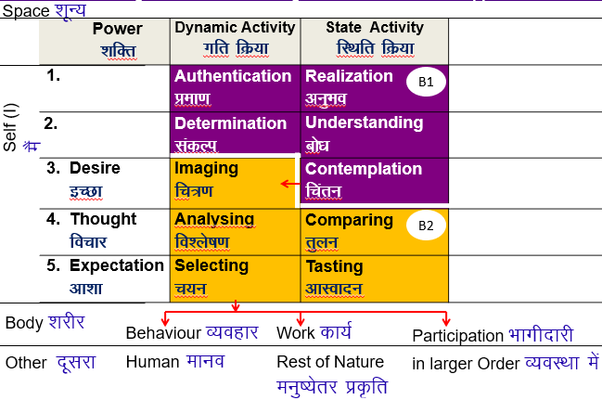
Knowledge of Human Being – Activities of Self (I) [CO5]

Slide 44
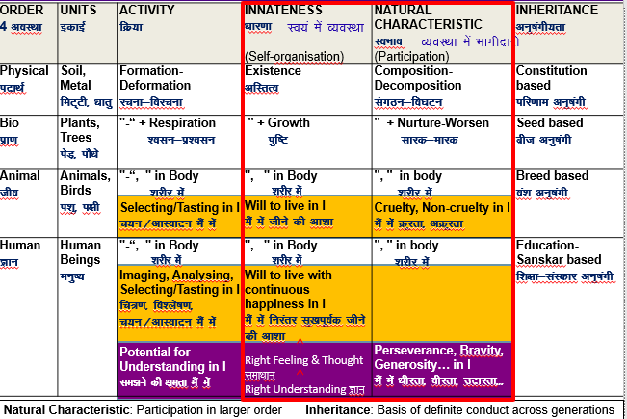
Innateness & Natural Characteristic of 4 Orders [CO5]

Slide 45
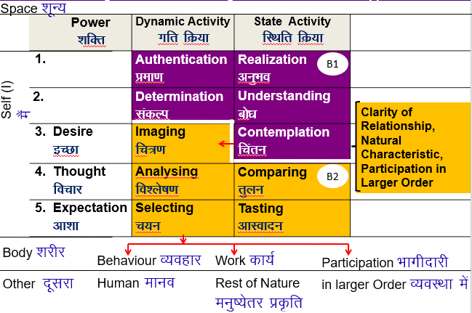
Knowledge of Human Being – Activities of Self (I) [CO5]

Slide 46
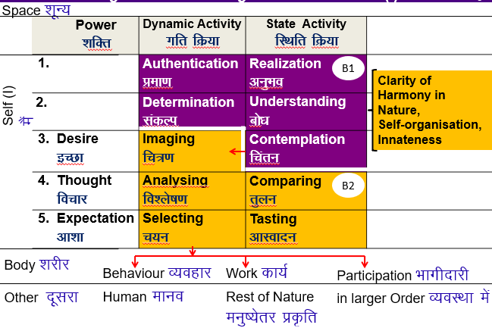
Knowledge of Human Being – Activities of Self (I) [CO5]

Slide 47
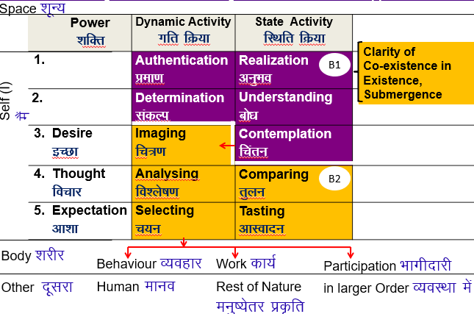
Knowledge of Human Being – Activities of Self (I) [CO5]

Slide 48
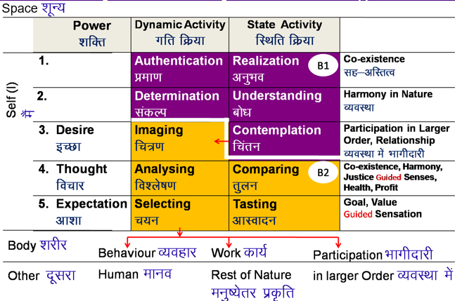
Knowledge of Human Being – Activities of Self (I) [CO5]

Slide 49
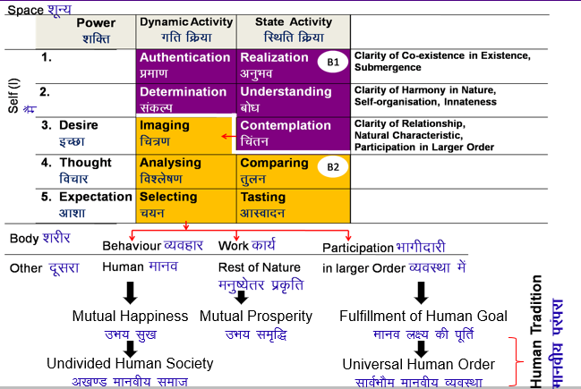
Realization of Co-existence & it’s expression – Universal Human Order [CO5]

Slide 50
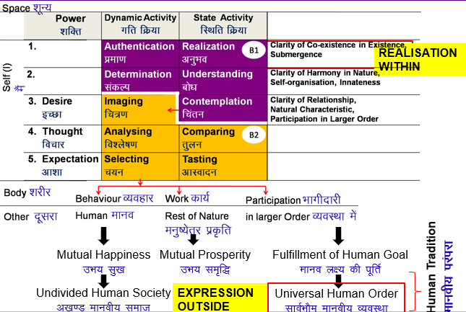
Realization of Co-existence & it’s expression – Universal Human Order [CO5]

Slide 51
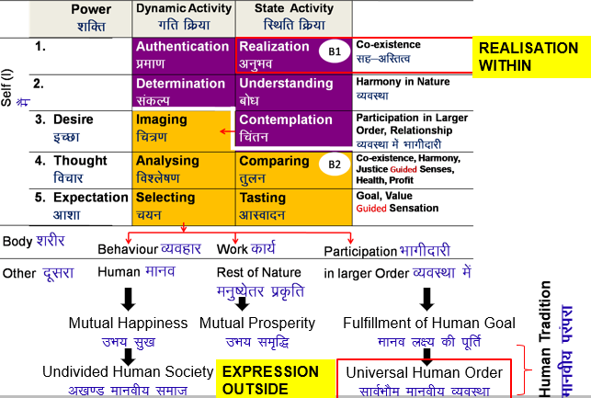
Realization of Co-existence & it’s expression – Universal Human Order [CO5]

Slide 52
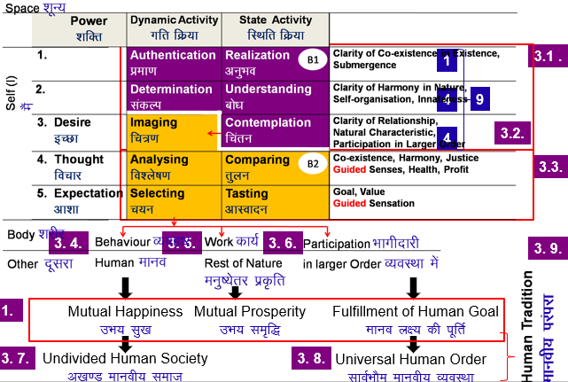
Realization of Co-existence & it’s expression – Universal Human Order [CO5]

Slide 53
Awakening Activity of Contemplation, Understanding & Realization [CO5]
Realisation: of Co-existence Existence is Co-existence
Every unit in Nature is:
    Energised in space
    Self-organised in space, exists in a definite order
    Recognises its relationship with every other unit and fulfills the relationship in space
I am a unit of consciousness in space
I am energised in space. Activities of desire, thought, expectation… are continuous in me
I am self-organised in space; I exist in a definite order
I have to rightly recognise my relationship with other units and fulfill it. When I do, I feel happy, when I do not, I feel unhappy…
With this realisation, I live with authenticity, in continuity

Slide 54
Awakening Activity of Contemplation, Understanding & Realization [CO5]
  Understanding: of Harmony (Self-organisation) in Nature
  All units in Nature can be classified into 4 orders. These units are connected to each other; there is a relationship of Mutual Fulfilment amongst them (Self-organisation or Innateness of 4 orders)
There is complementarity in Nature, no opposition
When I understand this, I am determined to live in a mutually fulfilling manner with every unit in existence
This definiteness leads to a feeling of Bliss (Anand)

Slide 55
Awakening Activity of Contemplation, Understanding & Realization [CO5]
  Contemplation: of My Participation in Larger Order
  What is my role in existence
What do I have to do as a Human Being, What is valuable for me as a human being
What is my participation in larger order… self, family, society, nature/existence
What is my value in existence (Human Value)
  Relationship of Mutual Fulfilment with Human Being → Mutual Happiness → Undivided Society
  Relationship of Mutual Enrichment with Rest of Nature → Mutual Prosperity
  Participation or Natural Characteristic of 4 orders → Participation in Larger Order → Fulfilment of Human Goal, Universal Human Order, Human Tradition

Slide 56
Awakening Activity of Contemplation, Understanding & Realisation [CO5]
On the basis of understanding my participation in existence, I can see that I have a definite role to play as a human being. Then my desire is to fulfil that definite role – on this basis my desires become definite
When I understand that Mutual fulflment is inherent in Nature, I am assured that these definite desires will be fulfilled
This leads to a feeling of Satisfaction/Contentment (Santosh)

Slide 57
Daily Quiz
1. Acceptance of excellence in others is called __________.
(a) Gratitude (b) Reverence
(c) Glory (d) None of above
2.Employing the body physically for production and maintenance of physical facilities is called __________.
(a) Labour (b) Work
(c) Skill (d) None of above
3.The problems in our relationship with various entities are due to our ______.
(a) Assumptions (b) Misunderstanding
(c) Differentiation (d) None of above
4. Human conduct is definite. (True/False)
5. The ‘I’ is the doer, sear and enjoyer. (True/False)

Slide 58
Recap of Topic 3
We have seen that science can be expanded as- science of behaviour, work and participation.
In the present day science, are we taking care of all three or only the science of work, in that too all aspects of it or only some limited aspects of it?
In the science of behaviour,
What will be priority of understanding, feelings and physical facility?
What is the role of physical facility in it?
In the science of participation, what do you see as your role at different levels- family order to nation to world family order?
Does the present education system prepare you for there roles?
What change is required in the present education system?

Slide 59
Prerequisite to Topic 4
Prerequisite
Student should be familiar to concepts right understanding, harmony, Human being as an Existence, Awakening of higher activities of the self and higher activities then guiding the lower activities of the self.

Slide 60
Introduction to Topic 4
Name of Topic | Objective of Topic | Mapping with CO
All Encompassing Resolution-Science of Work & Participation | Students will be able to see their role at different levels- family order to nation to world family order, according to the science of participation. | CO 5

Slide 61
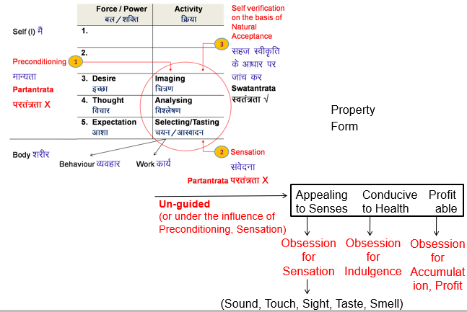
Knowledge of HB– Comparing (Basis for Analysing) [CO5]

Slide 62
Categories: Preconditioning, Sensation and Natural Acceptance [CO5]
Preconditioning: Assuming without knowing. Depends on something or someone outside, keeps changing. Not sure it leads to harmony or contradiction.
Sensation: taste of sound, touch, sight, taste, smell, 4 topics: food, sleep, fear/security, sex (samvedna – shabd, sparsh,
tasty-necessary → tasty-unnecessary → tasteless-unnecessary → intolerable
(ruchikar-avashyak → ruchikar-anavashyak → aruchikar-unavashyak →
Natural Acceptance: Given all the choice, what I accept naturally. Leads to harmony (happiness) within, continuity is desirable, possible
  Assurance (Ashwasti)
  Satisfaction (Tripti)
  Universal (Sarvbhaum)
Q: % Preconditioning, % Sensation and % Natural Acceptance

Slide 63
Sensation for Health of Body & Fulfillment of Purpose of Self (I) [CO5]
Role of sensation or right utilisation of sensation
    To keep body in good health by nurturing, protection of body
    To exchange right understanding & right feeling (Education-sanskar)
Sensation in animal naturally restrained (by nature) for health
Sensation in human being can make right utilisation of sensation
only with right understanding
Right utilisation of body [body is an instrument of the Self (I)
    As an instrument for communication
    As an instrument fpr labour, to obtain necessary physical facility for the body
    As an instrument for continuity of Human Tradition (new body)

Slide 64
Criteria for Comparing [CO5]
Co-existence Harmony
Appealing
to Senses
Conducive to Health
Profit
able
Justice
Authentication of co-existence, submergence in space. Mutual fulfilment
Ensuring the harmony, mutual enrichment in human-nature relationship
Living in a relationship of mutual fulfillment, justice in human-human relationship
Identification of right physical facility
Sanyam, ensuring health of body
Clarity about Prosperity

Slide 65
Criteria for Comparing [CO5]
Mutual Fulfilment with every unit, ensuring the comprehensive Human Goal and unconditional justice in human-human relationship are then the primary criteria for Comparing.
These three guide the right use of sensation, body and physical facility. So these guided choices enable using sensation for selecting appropriate physical facility for nurturing and protection, ensuring health of the body; using the body for self-development and societal development (comprehensive Human Goal); and using physical facility for ensuring mutual prosperity.

Slide 66
Comparing (Basis for Analysing) [CO5]
Authentication of co-existence, the submergence in space
Authentication of harmony, i.e. human-nature relationship, mutual enrichment (mutual prosperity)
Authentication of relationship, i.e. human-human relationship, mutual fulfilment (mutual happiness)
For identification of physical facility that is nurturing for the body, for protection of body, for behaviour / work, sharing knowledge, feeling.
Sanyam, clarity about program for sanyam ensuring health of body, so that body is capable of being used for ensuring right understanding and right feeling in the self as well as its authentication in living, including behavior, work and participation in larger order
Guided

Slide 67
Comparing (Basis for Analysing) [CO5]
For clarity about prosperity (identification, production & right utilisation of physical facility), so that nurturing, protection and right utilisation of the body and right utilisation of physical facility is ensured for relationship and societal order.

Slide 68
Daily Quiz
_________ means our ability to do or perform.
  Answer- Competence
Happiness and Prosperity are the two basic human desires.
a) True
b) False
The needs of the self are variable with time or place or people.
  a) True
  b) False
_________ Assuming without knowing.
  Answer- Preconditioning
________ taste of sound, touch, sight, taste, smell,
  Answer- Sensation

Slide 69
Recap of Topic 4
1. We have seen that science can be expanded as- science of behaviour, work and participation.
In the present day science, are we taking care of
    all three (science of behaviour, work and participation)?
    only the science of work, in all aspects of it?
    only the science of work, in only some limited aspects of it?
In the science of participation, what do you see as your role at different levels- family order to nation to world family order?
Does the present education system prepare you for there roles?
4. What change is required in the present education system?

Slide 70
Prerequisite to Topic 5
Prerequisite
Student should be familiar to concepts right understanding, harmony, Human being as an Existence, Awakening of higher activities of the self and higher activities then guiding the lower activities of the self.

Slide 71
Introduction to Topic 5
Name of Topic | Objective of Topic | Mapping with CO
Undivided Society, Universal Human Order, Human Tradition | Students will be able to understand their behavior, work and participation from family order to the world family order. | CO 5

Slide 72
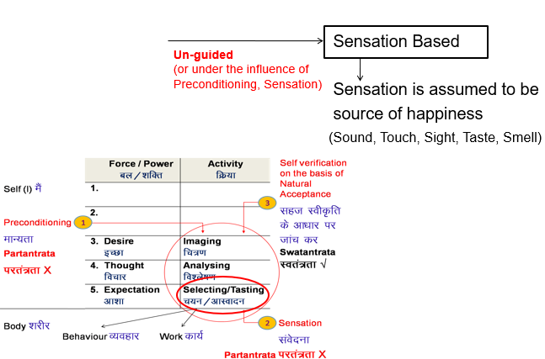
Knowledge of HB– Basis of Selection, Tasting [CO5]

Slide 73
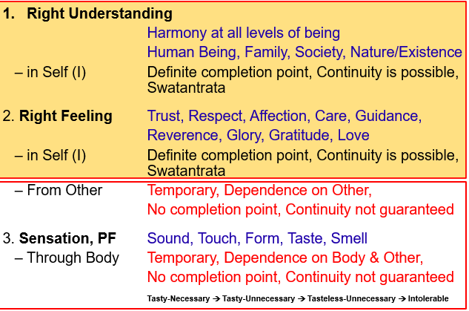
Sources of Happiness [CO5]

Slide 74
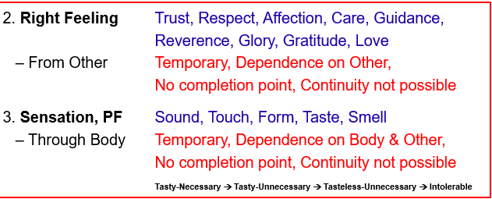
Sources of Excitement (Temporary Happiness) [CO5]

Slide 75
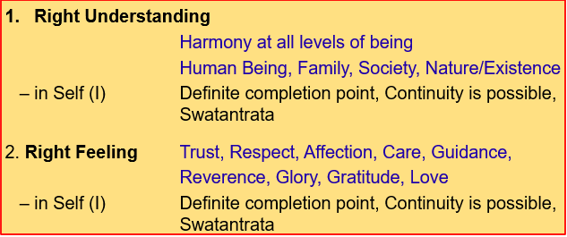
Sources of Continuous Happiness [CO5]

Slide 76
Purpose of Right Understanding, Right Feeling, Sensation/PF [CO5]
Right Understanding
Harmony at all levels of being
Human Being, Family, Society,Nature/Existence
– in Self (I) for happiness in the Self(I), definite completion pt.
2. Right Feeling Trust, Respect, Affection, Care, Guidance,
Reverence, Glory, Gratitude, Love
– in Self (I) for happiness in the Self(I), definite completion pt.
– From Other For evaluating state of other Self(I)
to identify complementarity in relationship
3. Sensation, PF Sound, Touch, Form, Taste, Smell
– Through Body For evaluating state of physical facility
to identify if it is OK for nurturing, protection
of body (health of body)
For behaviour / work, sharing knowledge, feeling

Slide 77
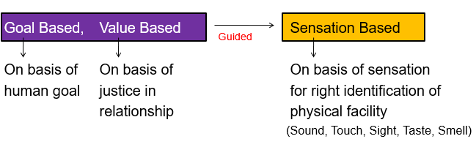
Knowledge of HB– Basis of Selection, Tasting [CO5]

Slide 78
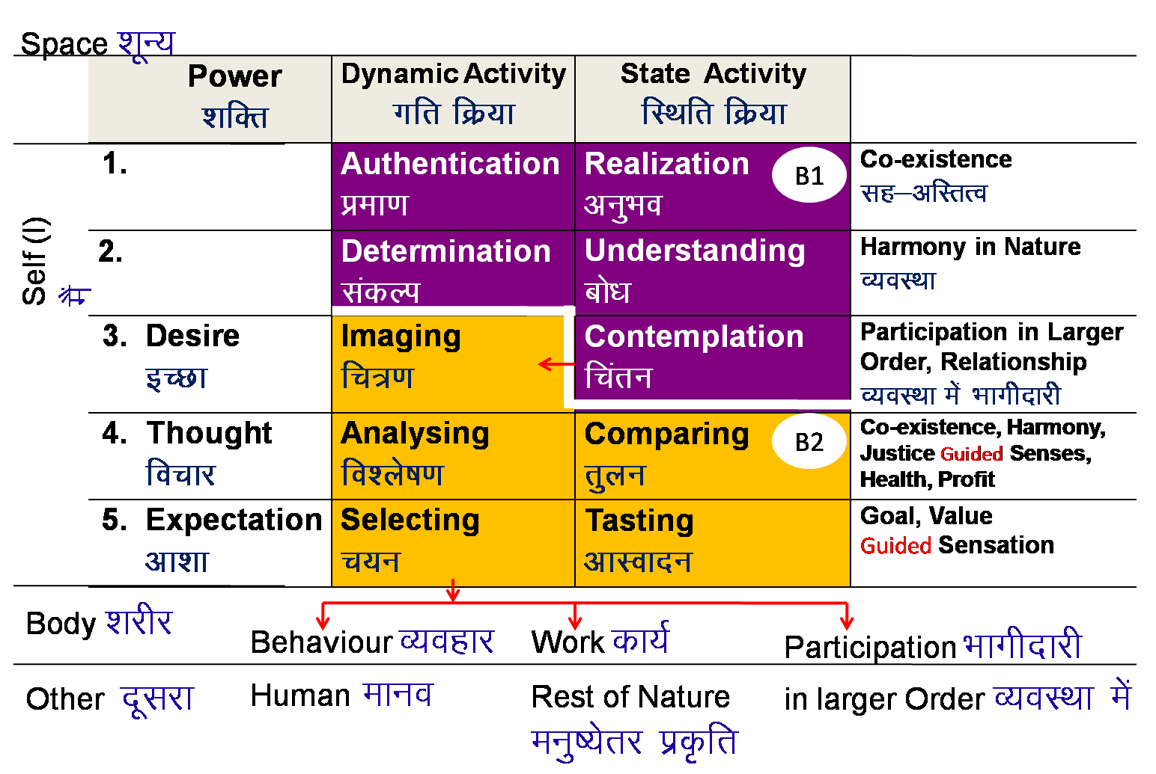
Knowledge of HB– Basis of Selection, Tasting [CO5]

Slide 79
Basis of Selection [CO5]
Selecting on the basis of human goal based tasting
  Awakening (in the self) – Harmony in the self leading to happiness, peace, satisfaction, bliss in the self (based on comparing on the basis of co-existence)
  Harmony (with entire nature) – Participation in larger order leading to 1-right understanding, and resolution (right feeling & right thought) in the self, 2-prosperity in every family, 3-fearlessness (trust) in society and 4-co-existence in existence (based on comparing on the basis of harmony)
Selecting on the basis of human value (feeling) based tasting
Justice in behaviour with human being (based on comparing on the basis of justice

Slide 80
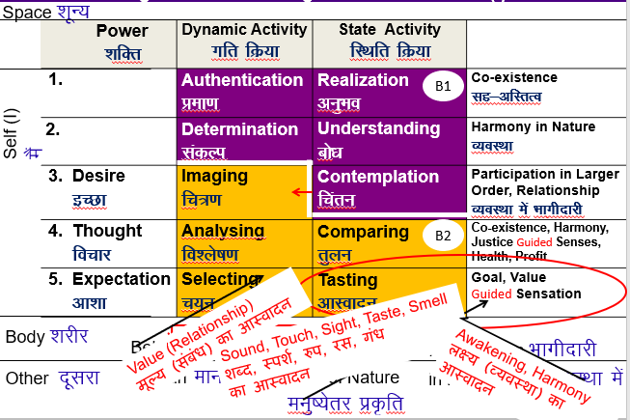
Knowledge of Human Being – Activities of Self (I) [CO5]

Slide 81
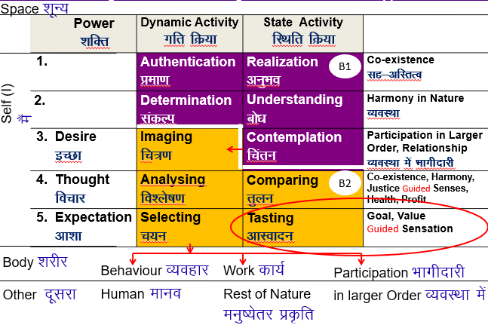
Knowledge of Human Being – Activities of Self (I) [CO5]

Slide 82
Daily Quiz
____________ means physical facilities more than to satisfy my needs.
  Answer: prosperity
Self and ______________ are different in nature, materiality, needs and activities.
  Answer: body
Any entity that has the activity of recognizing and fulfillment only can be called as _________.
  Answer: material entity
Based on the taste, the ______could be triggered.
  Answer: thoughts
In I (self), recognizing and fulfillment depends on ____________.
  Answer: assuming

Slide 83
Recap of Topic 5
Behaviour- the feeling of love is at the base and from there you are coming down to affection for a particular individual or otherwise
Work- mutual fulfillment with entire nature is at the base and from there you are coming down to mutual fulfillment with natural resources you are working with or otherwise
Participation- Participation in the Universal Human Order is at the base and from there you are coming down to Participation in the Family Order or otherwise

Slide 84
Weekly Assignment 1
What is the meaning of ‘contemplation’ as described in the course? Explain with the help of an example.
What are basic human aspirations?
How do you distinguish between a ‘prosperous’ person and a ‘deprived’ person in living? Explain.
How does any sensation produce only temporary happiness? Explain taking a few examples.
How does the ‘imaging’ in the Self get transformed with ‘Contemplation’? Explain with the help of two examples.

Slide 85
Weekly Assignment 2
Name the three kinds of tasting in the Self. How are they related?
How does the activity of ‘tasting’ in the Self get transformed with right understanding? Explain.
Describe the content of activities of dimension of Realization in the Self.
What are the sources of happiness for a human being? Classify them, and show their correlation.
Make a line sketch showing how imagination migrates from one issue to another. Then at each point, explain the activities of imaging, analysing and selecting. Take one example to illustrate.

Slide 86
Faculty Video Links, Youtube & NPTEL Video Links and Online Courses Details
Youtube/other Video Links
  https://www.youtube.com/watch?v=DO1HQuoUfBQ
  https://www.youtube.com/watch?v=nFAa4t1d0TA
  https://www.youtube.com/watch?v=-1VzEaPZWls
  https://www.youtube.com/watch?v=WNxF_hwxeB8&list=PLWDeKF97v9SP_Kt6jqzA3pZ3yA7g_OAQz&index=17
  https://www.youtube.com/watch?v=Cnw1nK3K5qk&list=PLWDeKF97v9SP_Kt6jqzA3pZ3yA7g_OAQz&index=15
  https://www.youtube.com/watch?v=nFAa4t1d0TA&list=PLWDeKF97v9SP_Kt6jqzA3pZ3yA7g_OAQz&index=16
  https://www.youtube.com/watch?v=tULgi8tNg9k&list=PLWDeKF97v9SP_Kt6jqzA3pZ3yA7g_OAQz&index=18

Slide 87
MCQ s
A perception associated with stimulation of a sense organ or with a specific body condition is known as _____________.
  Sensation b) Happiness
  c) Recognizing d) None
Basic human aspirations are-
  Continuous happiness b) Prosperity
  c) Both d) None
_________ means we have assumed something about our desires on the basis of prevailing notion about it.
  Natural Acceptance b) Preconditioning
  c) Self- Exploration d) None

Slide 88
MCQ s
I am the _________ entity and body is ____________ entity.
  Conscious & material b) material & Conscious
  c) Recognizing & Conscious d) None
Imagination is combination of-
  a) Desire &thought b) Desire, thought & expectation
  c)Expectation & thought d) None
Human being is a combination of sentiment (‘I’) and ___________
  Answer- Material body

Slide 89
Old Question Papers
Previous University Papers can be studied from following links-
https://abesit.in/library/download/B.Tech./Sem.7/2019-20/UNDERSTANDING-THE-HUMAN-BEING-COMPREHENSIVELY-ROE-074.pdf
https://abesit.in/library/download/B.Tech./Sem.3/2018-19/UNIVERSAL-HUMAN-VALUES-AND-PROFESSIONAL-ETHICS-RVE-301.pdf
https://abesit.in/library/download/B.Tech./Sem.3/2017-18/UNIVERSAL-HUMAN-VALUES-PROFESSIONAL-ETHICS-RVE-301.pdf

Slide 90
Expected Questions for University Exam
Critically examine the prevailing notions of happiness and prosperity and their consequences.
How is ‘expectation to live with continuous happiness’ different from ‘desire to live with continuous happiness’?
List the three bases of the activity of ‘comparing’ in the Self lacking right understanding. Explain each with an individual example.
List the three bases of the activity of ‘comparing’ that get activated in the Self with right understanding. How do they guide the other three bases of comparing? Explain with individual examples.
How does the activity of ‘tasting’ in the Self get transformed with right understanding? Explain.
What is the meaning of ‘contemplation’ as described in the course? Explain with the help of an example.

Slide 91
References
A Foundation Course in Human Values and Profession Ethics (Text Book and Teachers’ Manual), R. R. Gaur, R. Sangal, G. P. Bagaria (2010), Excel Books,New Delhi [ISBN 978-8-174-46781-2]
Avartansheel Arthshastra, A. Nagraj, Divya Path Sansthan, Amarkantak, India
Economy of Permanence – (a quest for social order based on non-violence), J.
C. Kumarappa (2010), Sarva-Seva-Sangh-Prakashan, Varansi, India
Slow is Beautiful, Cecile Andrews http://www.newsociety.com/Books/S/Slowis-Beautiful)

Slide 92
References
Thank You

